Slide 1
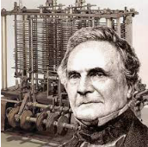
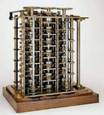
A history of Computers
1791 Charles Babbage, was an English mathematician, philosopher, inventor and mechanical engineer who originated the concept of a programmable computer. Considered a "father of the computer", Babbage is credited with inventing the first mechanical computer that eventually led to more complex designs. In 1991, a perfectly functioning difference engine was constructed from Babbage's original plans.
https://www.timetoast.com/timelines/the-history-of-computers--40
Peter J Faulks A history of Computers Slide 1

Slide 2
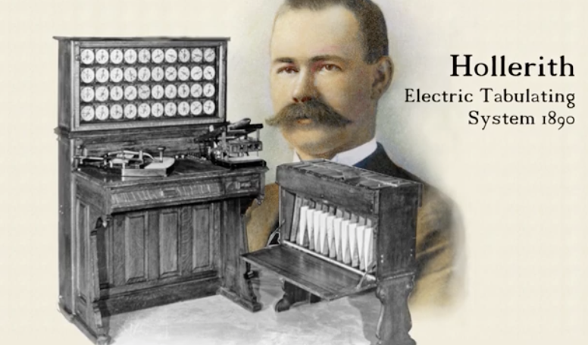
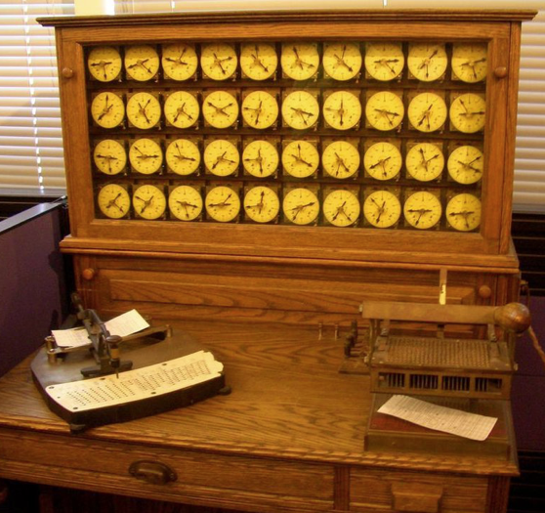
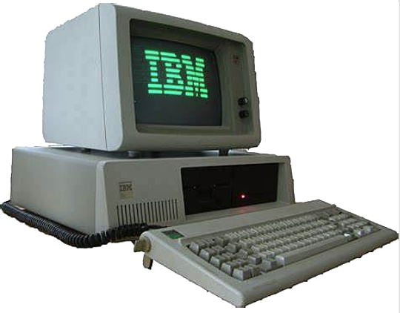
A history of Computers
1890 Herman Hollerith, an American inventor, built a machine to count a census. It used punched cards and gears like the previous ones, but it worked with electricity. His company grew to become the first computer manufacturer in the world: IBM.
1981 International Business Machines (IBM) computer
Peter J Faulks A history of Computers Slide 2

Slide 3
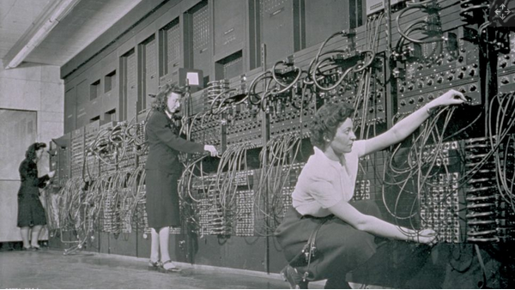
A history of Computers
1945: Two professors at the University of Pennsylvania, John Mauchly and J. Presper Eckert, design and build the Electronic Numerical Integrator and Calculator (ENIAC). The machine is the first "automatic, general-purpose, electronic, decimal, digital computer," But what drives the computer?
Peter J Faulks A history of Computers Slide 3

Slide 4
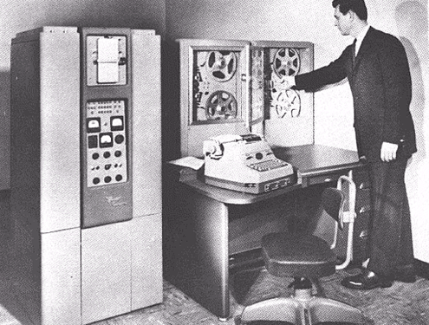
A history of Computers
1958
The second generation of computers starts, which used transistors to process information instead of vacuum tubes. New programming languages such as COBOL and FORTRAN were developed.
https://www.timetoast.com/timelines/history-of-computers-1f02cc77-9182-4543-8a04-0ab5551948e9
Peter J Faulks A history of Computers Slide 4

Slide 5
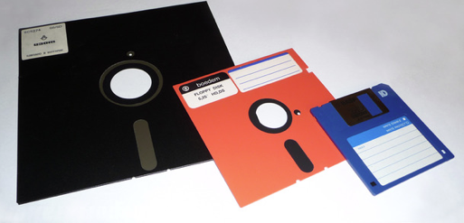
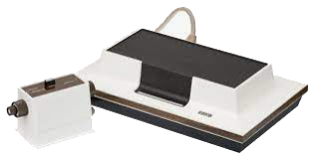
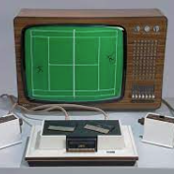
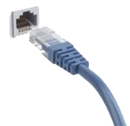
A history of Computers
1971: A team of IBM engineers led by Alan Shugart invents the "floppy disk," enabling data to be shared among different computers.
1972: Ralph Baer, a German-American engineer, releases Magnavox Odyssey, the world's first home game console, in September 1972 , according to the Computer Museum of America (opens in new tab). Months later, entrepreneur Nolan Bushnell and engineer Al Alcorn with Atari release Pong, the world's first commercially successful video game.
1973: Robert Metcalfe, a member of the research staff for Xerox, develops Ethernet for connecting multiple computers and other hardware.
Peter J Faulks
Peter J Faulks A history of Computers Slide 5

Slide 6
A history of Computers
1976: Steve Jobs and Steve Wozniak co-found Apple Computer on April Fool's Day. They unveil Apple I, the first computer with a single-circuit board and ROM (Read Only Memory), according to MIT (opens in new tab).
Peter J Faulks
Peter J Faulks A history of Computers Slide 6

Slide 7
A history of Computers
So how do we get these values? It seems odd that a kilobyte is 1024 bytes where a kilogram is 1000 grams. Why the extra 24 bytes? The answer is because in computing we use the base-2 numbering system, where as in the decimal system we are using a base-10.
Decimal Numbers
The easiest way to understand bits is to compare them to something you know: digits. A digit is a single place that can hold numerical values between 0 and 9. Digits are normally combined together in groups to create larger numbers. For example, 6,357 has four digits. It is understood that in the number 6,357, the 7 is filling the "1s place," while the 5 is filling the 10s place, the 3 is filling the 100s place and the 6 is filling the 1,000s place. So you could express things this way if you wanted to be explicit:
Peter J Faulks
Peter J Faulks A history of Computers Slide 7

Slide 8
A history of Computers
Base-2 Numbering System
In a base-2 numbering system, numbers are composed of only 0s and 1s, like this: 1101. How do you figure out what the value of the binary number 1101 is?
(1 * 2³) + (1 * 2²) + (0 * 2¹) + (1 * 2⁰)
= 8 + 4 + 0 + 1
= 13
So how do we get 1024 bytes, not 1000 bytes? Let us look at the following equation. In a base-2 numbering system this is the closest that you can get to 1000. When we are referring to gigabytes of space these 24 bytes becomes quite large (over 73MB in fact).
(1 * 2⁹) + (1 * 2⁸) + (1 * 2⁷) + (1 * 2⁶) + (1 * 2⁵) + (1 * 2⁴) + (1 * 2³) + (1 * 2²) + (1 * 2¹) + (1 * 2⁰)
= 512 + 256 + 128 + 64 + 32 + 16 + 8 + 4 + 2 + 1
= 1024
Peter J Faulks
Peter J Faulks A history of Computers Slide 8

Slide 9
A history of Computers
http://computer.howstuffworks.com/bytes.htm
Experiment
Have a go at converting the following decimal numbers to their binary equivalent.
25, 10, 181, 327
So computers use binary numbers, and therefore use binary digits in place of decimal digits. The word bit is a shortening of the words "Binary digIT." Whereas decimal digits have 10 possible values ranging from 0 to 9, bits have only two possible values: 0 and 1. Therefore, a binary number is composed of only 0s and 1s, like this: 1011. How do you figure out what the value of the binary number 1011 is? You do it in the same way we did it above for 6357, but you use a base of 2 instead of a base of 10. So:
(1 * 2^3) + (0 * 2^2) + (1 * 2^1) + (1 * 2^0) = 8 + 0 + 2 + 1 = 11
Peter J Faulks
Peter J Faulks A history of Computers Slide 9

Slide 10
A history of Computers
The Standard ASCII Character Set (American Standard Code for Information Interchange)
Bytes are frequently used to hold individual characters in a text document. In the ASCII character set, each binary value between 0 and 127 is given a specific character. Most computers extend the ASCII character set to use the full range of 256 characters available in a byte. The upper 128 characters handle special things like accented characters from common foreign languages.
If we wrote "Four score and seven years ago” in a document the document will show that it has 367 BYTES and takes 4 kb disk space
But the computer reads this li numbers set by ASCII (No 32 is a space)
Peter J Faulks A history of Computers Slide 10

Slide 11
A history of Computers
1971: A team of IBM engineers led by Alan Shugart invents the "floppy disk," enabling data to be shared among different computers.
1972: Ralph Baer, a German-American engineer, releases Magnavox Odyssey, the world's first home game console, in September 1972 , according to the Computer Museum of America (opens in new tab). Months later, entrepreneur Nolan Bushnell and engineer Al Alcorn with Atari release Pong, the world's first commercially successful video game.
1973: Robert Metcalfe, a member of the research staff for Xerox, develops Ethernet for connecting multiple computers and other hardware.
Peter J Faulks
Peter J Faulks A history of Computers Slide 11

Slide 12
A history of Computers
1971: A team of IBM engineers led by Alan Shugart invents the "floppy disk," enabling data to be shared among different computers.
1972: Ralph Baer, a German-American engineer, releases Magnavox Odyssey, the world's first home game console, in September 1972 , according to the Computer Museum of America (opens in new tab). Months later, entrepreneur Nolan Bushnell and engineer Al Alcorn with Atari release Pong, the world's first commercially successful video game.
1973: Robert Metcalfe, a member of the research staff for Xerox, develops Ethernet for connecting multiple computers and other hardware.
Peter J Faulks
Peter J Faulks A history of Computers Slide 12

Slide 13
A history of Computers
1971: A team of IBM engineers led by Alan Shugart invents the "floppy disk," enabling data to be shared among different computers.
1972: Ralph Baer, a German-American engineer, releases Magnavox Odyssey, the world's first home game console, in September 1972 , according to the Computer Museum of America (opens in new tab). Months later, entrepreneur Nolan Bushnell and engineer Al Alcorn with Atari release Pong, the world's first commercially successful video game.
1973: Robert Metcalfe, a member of the research staff for Xerox, develops Ethernet for connecting multiple computers and other hardware.
Peter J Faulks
Peter J Faulks A history of Computers Slide 13

Slide 14
A history of Computers
1971: A team of IBM engineers led by Alan Shugart invents the "floppy disk," enabling data to be shared among different computers.
1972: Ralph Baer, a German-American engineer, releases Magnavox Odyssey, the world's first home game console, in September 1972 , according to the Computer Museum of America (opens in new tab). Months later, entrepreneur Nolan Bushnell and engineer Al Alcorn with Atari release Pong, the world's first commercially successful video game.
1973: Robert Metcalfe, a member of the research staff for Xerox, develops Ethernet for connecting multiple computers and other hardware.
Peter J Faulks
Peter J Faulks A history of Computers Slide 14

Slide 15
A history of Computers
1971: A team of IBM engineers led by Alan Shugart invents the "floppy disk," enabling data to be shared among different computers.
1972: Ralph Baer, a German-American engineer, releases Magnavox Odyssey, the world's first home game console, in September 1972 , according to the Computer Museum of America (opens in new tab). Months later, entrepreneur Nolan Bushnell and engineer Al Alcorn with Atari release Pong, the world's first commercially successful video game.
1973: Robert Metcalfe, a member of the research staff for Xerox, develops Ethernet for connecting multiple computers and other hardware.
Peter J Faulks
Peter J Faulks A history of Computers Slide 15

Slide 16
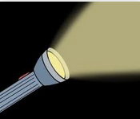
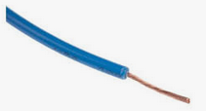
A history of Computers
Bits
If we have a torch it is either on or off and we have a switch that is switched on or off so we only have two stages 1 on or 0 off
Peter J Faulks A history of Computers Slide 16

Slide 17
A history of Computers
Bytes
Will give us more options if we have 8 bits we get 256 combinations of characters
So we can cover the English language and have lots of combinations for spaces, delete or commas etc.
It si still 1 on or 0 off but combined 8 times
Peter J Faulks A history of Computers Slide 17

Slide 18
A history of Computers
1971: A team of IBM engineers led by Alan Shugart invents the "floppy disk," enabling data to be shared among different computers.
1972: Ralph Baer, a German-American engineer, releases Magnavox Odyssey, the world's first home game console, in September 1972 , according to the Computer Museum of America (opens in new tab). Months later, entrepreneur Nolan Bushnell and engineer Al Alcorn with Atari release Pong, the world's first commercially successful video game.
1973: Robert Metcalfe, a member of the research staff for Xerox, develops Ethernet for connecting multiple computers and other hardware.
Peter J Faulks
Peter J Faulks A history of Computers Slide 18

Slide 19
A history of Computers
1971: A team of IBM engineers led by Alan Shugart invents the "floppy disk," enabling data to be shared among different computers.
1972: Ralph Baer, a German-American engineer, releases Magnavox Odyssey, the world's first home game console, in September 1972 , according to the Computer Museum of America (opens in new tab). Months later, entrepreneur Nolan Bushnell and engineer Al Alcorn with Atari release Pong, the world's first commercially successful video game.
1973: Robert Metcalfe, a member of the research staff for Xerox, develops Ethernet for connecting multiple computers and other hardware.
Peter J Faulks
Peter J Faulks A history of Computers Slide 19

Slide 20
The End

